Slide 1


Bicycle Safety Skills
Presented by:
The Orleans Bike and Walkways Committee
November 24, 2010

Slide 2

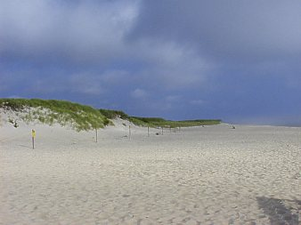
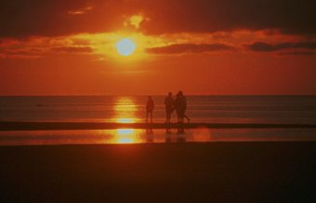

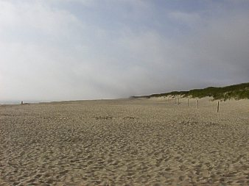
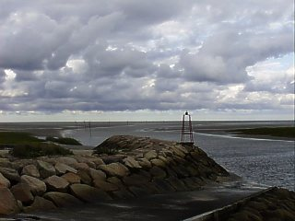
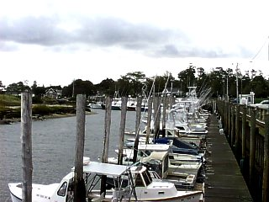
Welcome to Orleans
Notes:
Overview
The Orleans Bikeways Committee welcomes you, our visitors and all our International Workers to Orleans. You are very important part of our Summer tourist season and we want to be sure that you enjoy safe bicycling during your stay on Cape Cod.
We understand that the rules of the road may be different than in your country or State so here is an overview of our traffic rules and regulations to assure your biking safety by helping you understand how to safely navigate our roads and trails.
To help you better understand this information, key points are highlighted in RED and repeated where appropriate.
We ask you to take about 10 minutes out of your busy schedule to review this material and hope you have a safe and enjoyable summer in Orleans

Slide 3
Bikes are vehicles?
What does that mean?
That means you should ride your bike as if you are driving a car.
Preferred Cyclist Behaviors
  You may take the lane (if you are comfortable doing so)
  Follow the Rules of the Road
  Drive your Bike in the same direction as other traffic
  Ride predictably
  Hold your line
    Don’t weave in and out of traffic.
Notes:
Bikes are vehicles which means that you should drive your bike as if you were driving a car.
Here are the Preferred Cyclist Behaviors that you should follow.
You may Take the lane or drive in the road lane (if you are comfortable doing so)
You must follow the Rules of the Road and obey all signs and traffic signals.
You must drive your bike in the same direction as other traffic
Ride predictably-
Hold your line , don’t weave in and out of traffic.

Slide 4
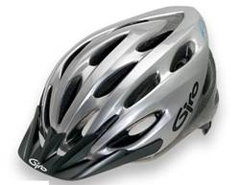

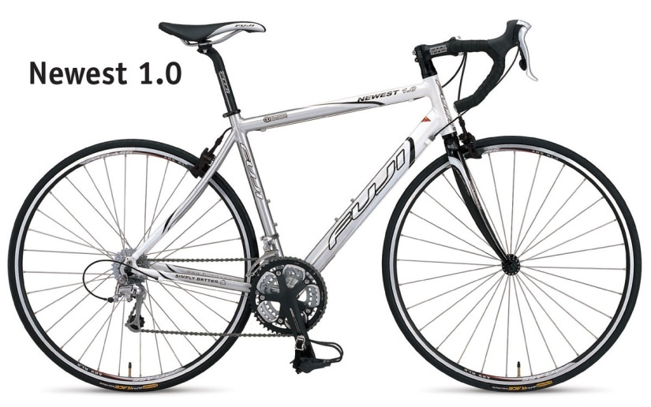
Get ready to ride and Protect Yourself
Wear a Helmet
For your safety, you should always wear
a well fitted Bicycle Helmet.
The law requires that bicyclists age 16
and younger must wear a helmet.
Be Bright and Dress Right
Wear light, white or Bright clothing and make sure you have no loose shoe laces, straps, or clothing that can get caught in moving parts.
Brakes
Check your Bike for Safety!
Do the A B C Quick Check by checking your Air (Tire pressure), Brakes, Chain (and gears), and Quick Releases on your wheels to be sure they are all working properly.
Air
Chain
Quick Releases
Notes:
Follow these few steps and bicycling will become much easier and enjoyable.
1- For your safety always wear a well fitted helmet.
2- Be Bright and Dress right
Wear light, white or Bright clothing and make sure you have no loose shoe laces, straps, or clothing that can get caught in moving parts.
3- Check your Bike for Safety!
Do the A B C Quick Check:
Air, Inflate your tires to the pressure indicated on the sidewall.
Brakes, make sure they work correctly
Chain, Check your bike’s Gears Shifting, and the Quick Releases on your wheels to be sure they are all working properly.
4- You should operate your bicycle like a driver of a vehicle. You are a part of traffic. Drive your bicycle as if you belong on the road. Learn how to operate your bicycle in traffic.

Slide 5
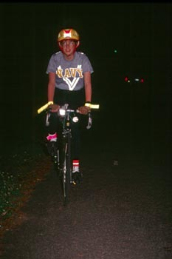
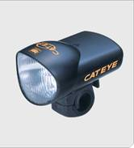
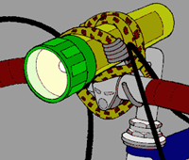
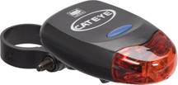

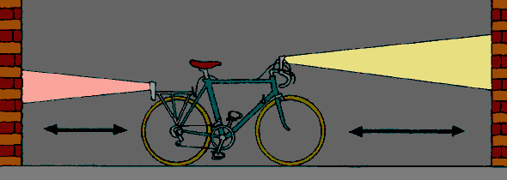
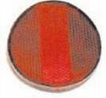
Get ready to ride and Protect Yourself
Equip your bike for Night Riding
Your bike must be equipped with a white headlight and red taillight for night riding. They must be on if you are riding anytime from 1/2 hour after sunset until 1/2 hour before sunrise
Reflectors must be on the pedals, both wheels, and at the front and rear of the bike.
-OR-
Notes:
If you will be driving your bicycle at night, you or your bike must be equipped with a white headlight, a red tail light, reflectors on the wheels, pedals and on the bike’s front and rear.
Your lights must be on if you are riding after sunset and before sunrise.

Slide 6
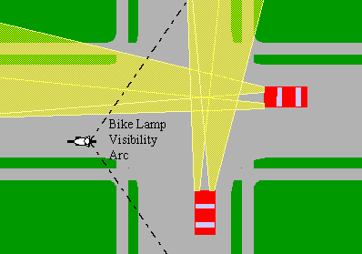
Night Riding
You always need to be visible and predictable
1- Automobiles can’t see you because their headlights do not illuminate your reflectors.
A headlight on the bicycle is much more visible to automobile drivers in these locations
Notes:
When biking at night you always need to be Visible and Predictable
Be sure to wear bright colored clothes and have all required reflectors on your bike. While reflectors provide some visibility, automobile headlights often do not shine upon the reflectors of a bicycle until it is too late to avoid a collision.
You may feel you can see well enough to ride, without a headlight. This can be very dangerous, because without a headlight other drivers often can not see you, even under street lamps.
Let’s look at the pictures:
1-Automobile headlights often do not illuminate the cyclist's reflectors, creating a danger at intersections. A headlight on the bicycle is much more visible to drivers in these locations.

Slide 7
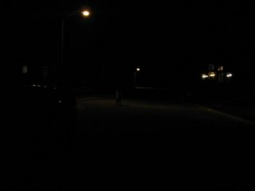
Night Riding
You always need to be visible and predictable
1- Vehicles can’t see you because their headlights do not illuminate your reflectors.
A headlight on the bicycle is much more visible to drivers in these locations
2- An approaching cyclist in the roadway under a street lamp, with no front light
Vehicles cannot see you.
Notes:
Picture Number 2-
Here is an approaching cyclist in the roadway under a street lamp, with no front light.
Vehicles cannot see you.

Slide 8
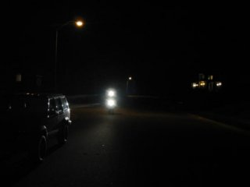
Night Riding
You always need to be visible and predictable
1- Vehicles can’t see you because their headlights do not illuminate your reflectors.
A headlight on the bicycle is much more visible to drivers in these locations
2- An approaching cyclist in the roadway under a street lamp, with no front light
Vehicles cannot see you.
3- A cyclist approaching in the same position as picture number 2, this time with a headlight.
With lights, they can see you
Notes:
Picture Number 3-
Here is a cyclist approaching in the same position as Picture # 2, this time with a headlight.
With Lights they can now see you.

Slide 9
Signal Your Turns
Bicyclists must use hand signals when stopping and turning.
  Signal then put both hands back on the handlebars!
  Don’t signal when it is dangerous to take a hand off the bars!
Notes:
Signal Your Turns
Bicyclists must use hand signals when stopping and turning.
Signal then put both hands back on the handlebars!
Don’t signal when it is dangerous to take a hand off the bars!
Now let’s look at the hand signals as seen from the rear.

Slide 10
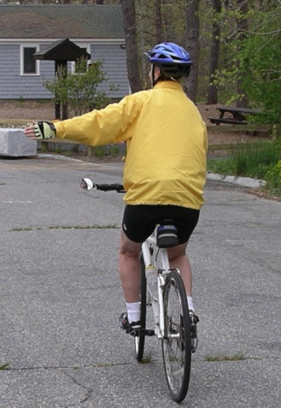
Signal Turns
Left Turn
To make a left turn extend your left arm straight out to the side
As viewed from the rear
Notes:
To signal a Left Turn:
Extend your Left arm straight to your left side.

Slide 11
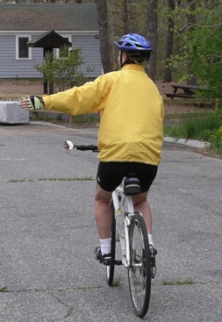
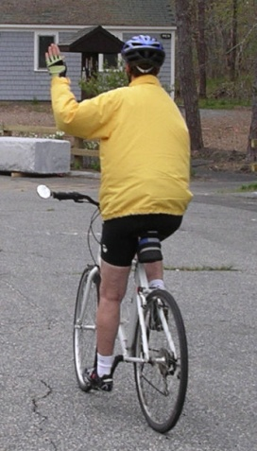
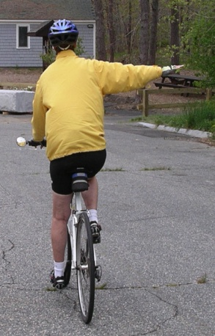
Signal Turns
Left Turn
To make a left turn extend your left arm straight out to the side
Right Turn
To make a right turn, bend your left arm in an upward position.
-OR-
Extend your right arm straight out to the side.
As viewed from the rear
Notes:
To Signal a Right Turn:
Bend your left arm in an upward position
-or-
Extend your right arm straight out to right side.

Slide 12


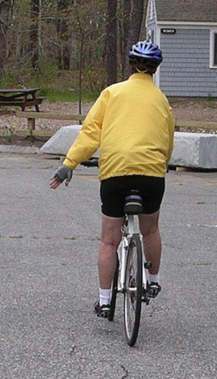
Signal Turns
You must use hand signals to let people know you plan to stop or turn.
Left Turn
To make a left turn extend your left arm straight out to the side
Right Turn
To make a right turn bend your left arm in an upward position
Extend your right arm straight out to the side.
-OR-
Stop
To Stop extend your left arm in a downward motion.
Notes:
To Signal a Stop:
Extend your left arm in a downward motion.
Now Practice these signals so they will be automatic

Slide 13




Understanding our Road Signs and Traffic Lights
Cars and bicyclists go.
Slow down and prepare to stop.
Cars and bicyclists stop.
Notes:
Understanding our Road Signs and Traffic Lights
Green Light: When the signal light turns green, cars and bike riders go. Remember that cars may be turning, so be sure to look carefully to your left, your right, and to the left again before crossing the street.
Yellow Light: When the signal light turns yellow, cars and bike riders should slow down and prepare to stop. If you are waiting to cross the street, you should not cross if the light is yellow.
Red Light: When the signal light turns red, cars and bicyclists should stop.

Slide 14




Understanding our Road Signs and Traffic Lights
Slow down and prepare to stop.
Cars and bicyclists stop.
Cars and bicyclists go.
Pedestrians and bikers walking their bicycle can cross the street.
Use caution.
If you are in the street, finish crossing the street.
Notes:
Understanding our Road Signs and Traffic Lights
Walk Signal: The WALK signal means that it is okay is for Pedestrians and bikers walking their bicycle to cross the street.
BUT you should always look both ways, by looking to your left, right and left again to make sure no cars are coming or turning.
DON’T WALK: When the red "DON'T WALK" sign is flashing, it means use caution.
If you are in the street, finish crossing the street.
If you have not started crossing the street, stay on the curb

Slide 15


Understanding our Road Signs and Traffic Lights
Cars and bicyclists go.
Slow down and prepare to stop.
Cars and bicyclists stop.
Pedestrians and bikers walking their bicycle can cross the street.
Use caution.
If you are in the street, finish crossing the street.
You must come to a complete stop at a STOP sign.
Slow down and be ready to stop.
If there are pedestrians or vehicles in or nearing the intersection, you must stop.
If there is no traffic in or nearing the intersection and it is safe,
you may go through.
Notes:
Understanding our Road Signs and Traffic Lights
STOP SIGN: ALL Car drivers and bicyclists must come to a complete stop at STOP signs.
When there are no vehicles or pedestrians in the intersection and it is safe, you may go through the intersection.
YIELD SIGN: A yield sign means to slow down and be ready to stop.
If there are pedestrians or vehicles in or nearing the intersection, you must stop.
If there is no traffic in or nearing the intersection and it is safe, you may go through.

Slide 16
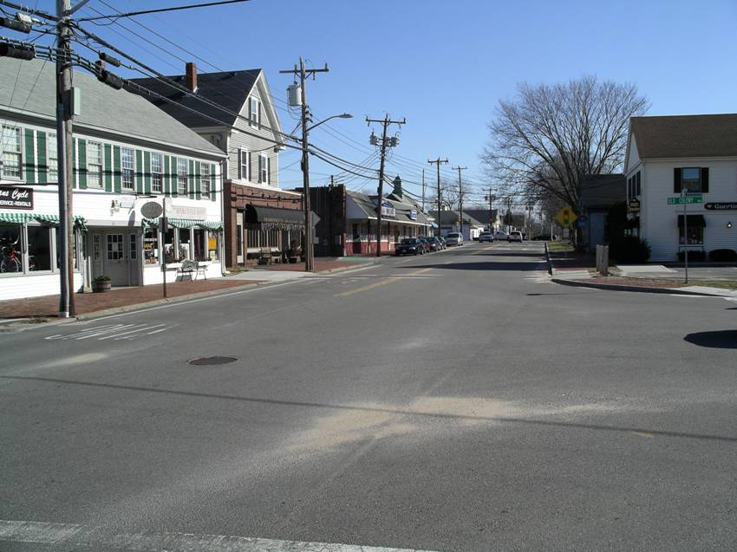
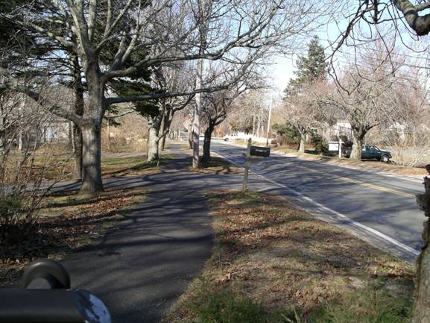
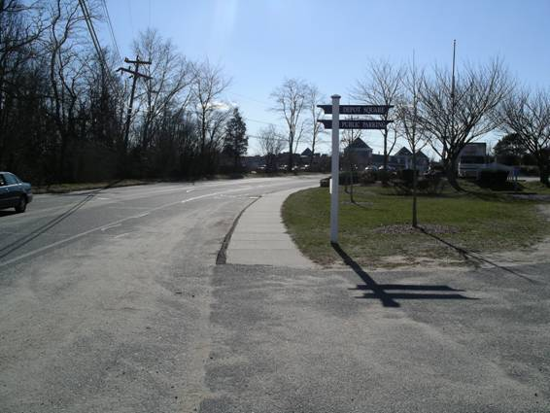
Sidewalks
Do not drive your bicycle on the sidewalk on Main Street.
Do not drive your bicycle on Sidewalks on Main Street
You may only drive your bicycle on sidewalks outside business districts
OK
OK
Notes:
Sidewalks
Sidewalks are designed for pedestrians and it is dangerous to drive your bicycle on sidewalks. Pedestrians always have the right of way on sidewalks.
Bicyclists who drive on sidewalks and crosswalks face danger from vehicles turning into or entering from driveways and side streets. When you come off the sidewalk to cross the street you're invisible to motorists and you could be involved in an accident.
You may only drive your Bicycle on sidewalks outside business districts.
Do not drive your bicycle on the sidewalk on Main Street.

Slide 17
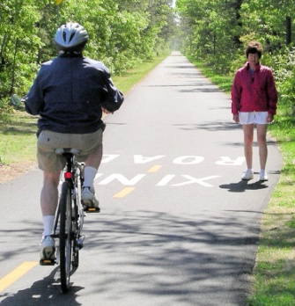
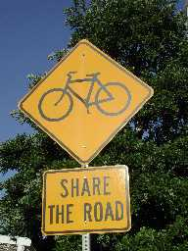
Bicyclists must Share the Road/Bike Path and Yield to Pedestrians
Head-On
-Bikers should keep to the RIGHT
Approaching from the Rear
- Pass as far away as you can to avoid startling them.
- Give them an audible signal (Horn/Bell) or say "Passing left," or "Passing right“
- Give Kids as much space as you can and never get between a child and its parent.
Crosswalks
-Pedestrians have the right of way in crosswalks where there are no functioning traffic signals.
- You must slow or stop to let someone cross who is on your half of the road or close to it.
- Slow down, if someone is approaching a crosswalk, try to get their attention.
- Stop if they step out in front of you.
Intersections between the Bike Path and a Road
- You must STOP at All road crossings.
- Remember you are considered a vehicle when driving your bike and you must wait until it is clear before crossing a road.
- When you walk your Bike you are considered a pedestrian and you have the right of way.
Meeting on a Road
- On a road without sidewalks, you will meet head-on so give pedestrians or joggers the shoulder and you should drive your bicycle on the road.
- Again, signal your intention.
Notes:
Bicyclists must Share the Road or Bike path and yield to Pedestrians.
Bikers should drive on the right side of the trail.
Head-On
If you're meeting a pedestrian who is facing you on the bike path, there is an immediate dilemma.
As the faster moving participant , the bicyclist must chose where to go. Pick the side with the most room, and make eye contact before passing.
Approaching from the Rear
When approaching a pedestrian from the rear, pass as far away as you can to avoid startling them.
Give them an audible signal by ringing your Horn or Bell or say "Passing left," or "Passing right“ to let them know that there's a bicycle approaching and what action they should take.
Give Kids as much space as you can and never get between a child and its parent.
Crosswalks
According to state law, pedestrians have the right of way in crosswalks where there are no functioning traffic signals. This means you must slow or stop to let someone cross who is on your half of the road or close to it. If someone is approaching a crosswalk, prepare to slow down, and try to get their attention. If they step out in front of you, stop.
Intersections between the Bike Path and a Road
You must STOP at All road crossings.
Remember you are considered a vehicle if riding on your bike and you must wait until it is clear before crossing a road.
If you are walking your Bike you are considered a pedestrian and you have the right of way.
Meeting on a Road
On a road without sidewalks, you will meet head-on so give pedestrians or joggers the shoulder , as they have the right of way and you should ride on the road..
Again, signal your intention.

Slide 18
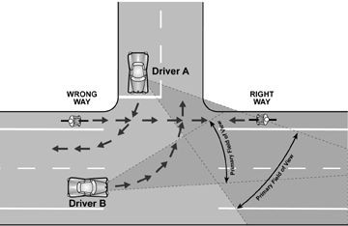
Basics of Traffic Cycling
When driving your Bicycle you are considered a vehicle and must obey all traffic laws.
  You must signal when you plan to stop or turn.
  You must give pedestrians the right of way and audible signal before overtaking or passing them. Ring your Bell or say “passing left” or “passing right”
  You Must Drive your bicycle on the Right Side of the Road
  You may drive you bike two abreast (two bicycles, side-by-side) except when faster vehicles need to pass. So stay in a single file when cars need to get by! On multi-lane roads, you can ride two abreast, but all the cyclists in your group must stay in one lane.
Both Drivers have a clear view of the Bicyclist going the Right Way
-Driving against traffic (On the LEFT ) puts you in a collision path with vehicles coming from the other direction.
You also cannot see traffic lights
You are directly in the path of oncoming bicyclists.
Wrong-way bicyclists get hit because they are not where car drivers are looking, primarily at intersections.
The wrong way cyclist is outside of the field of view of both driver A and driver B.
Wrong Way Biker
Right Way Biker
X
X
Notes:
Here are a few basics of Traffic Cycling
When driving your Bicycle you are considered a vehicle and must obey all traffic laws.
You must signal all turns and when stopping.
You must give pedestrians the right of way and audible signal before overtaking or passing them such as by ringing your Bell or saying “Passing on your left” or “Passing on your Right.”
You Must Drive your bike on the Right side of the road
You may drive you bike two abreast (two bicycles, side-by-side) except when faster vehicles need to pass. So stay in a single file when cars need to get by! On multi-lane roads, you can ride two abreast, but all the cyclists in your group must stay in one lane.
Driving on the wrong side of the road (On the LEFT) puts you in a collision path with vehicles coming from the other direction.
You also cannot see traffic lights
You are directly in the path of oncoming bicyclists.
Wrong-way bicyclists get hit because they are not where drivers are looking, primarily at intersections.
The wrong way cyclist is outside of the field of view of both driver A and driver B.

Slide 19
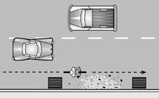
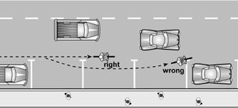
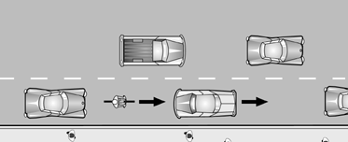
Basics of Traffic Cycling
Where to drive your bike
1
1-Drive your bicycle a safe distance away from hazards along the edge of the road such as drain grates and debris.
Drive your bike ½ Meter from the Curb
Drive about ½ Meter from obstacles
2
2-Drive your bicycle on a straight line. Don't weave around parked cars. Allow 3 feet (1 Meter) from a parked car whose door might open.
Drive 1 Meter
from
parked cars
Correct
Wrong
3
3-If the lane is too narrow to share with a car, drive your bicycle in the middle of the lane.
Notes:
1-Drive your bicycle a safe distance away from hazards along the edge of the road such as drain grates and debris
2-Drive a straight line. (Be predictable)
Don't weave around parked cars.
Allow sufficient space of about 3 feet (1 Meter) from a parked car whose door might open.
3-If the lane is too narrow to share with a car, drive in the middle of the lane.
Basics of Traffic Cycling
Where to drive your bicycle on the road:

Slide 20
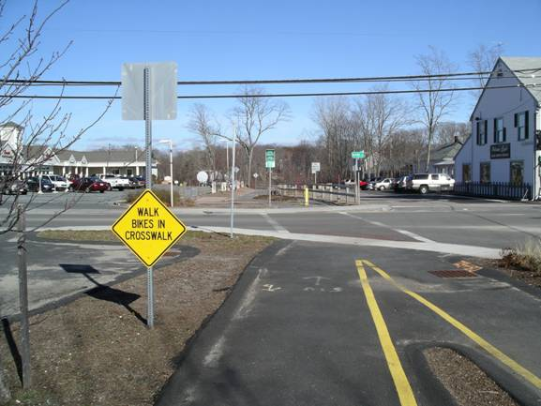
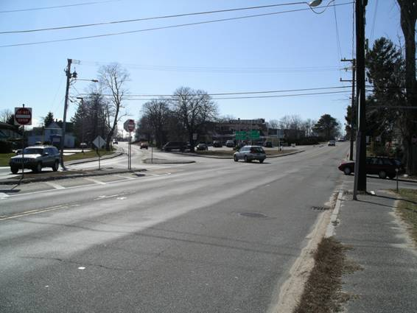
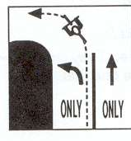
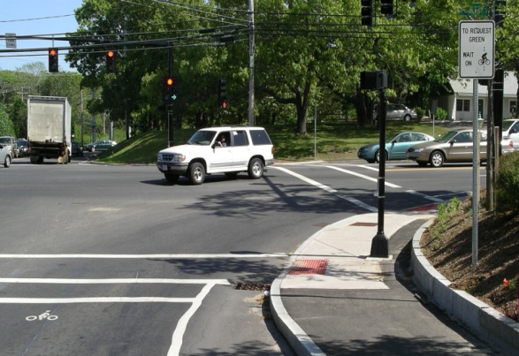
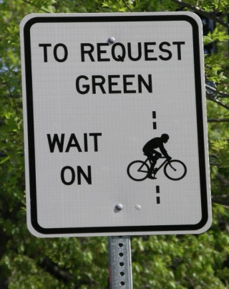
Biking in Orleans
Be careful as many of our roads are narrow and some of our intersections are challenging:
1-Rail Trail crossing at Main Street & Old Colony
-Please dismount and walk your bike when crossing this intersection.
2-Route 6A and Route 28
-This is a busy intersection where major roads come together and there are no traffic signals.
3-Making a left turn
Other major intersections where you should exercise caution are:
4-Skaket Corners
This is a very busy intersection and has recently been reconstructed with special sensors that will change the signal lights for Bicyclists.
  5-Stop & Shop
  Making a left turn leaving the parking lot
  This is a very busy intersection with traffic signals.
  Follow traffic signals and proceed with caution.
Notes:
Biking in Orleans
Be careful as many of our roads are narrow and some of our intersections are challenging:
Let’s take a look at a few intersections:
1-Rail Trail crossing at Main Street & Old Colony
-You must dismount and walk your bike when crossing this intersection.
2-Route 6A and Route 28
-This is a very busy intersection where major roads come together and there are no traffic signals.
3- Making a left Turn
- Keep to the right of the left turn lane and proceed when it is safe being sure to give a left turn signal.
4-Skaket Corners
This is a very busy intersection and has recently been reconstructed with special sensors that will change the signal lights for Bikers.
5-Stop & Shop
Making a left turn leaving the parking lot
This is a very busy intersection with traffic signals.
Follow traffic signals and proceed with caution.

Slide 21
Summary
These concepts may be confusing at first, but with practice they become natural and they are not different from driving a car.
When Driving your Bicycle you are considered a vehicle and must obey all traffic laws.
Having a bike in good working order, a well-fitting helmet, and lights for safe night driving are essential.
You must give pedestrians the right of way.
You must give pedestrians an audible signal before overtaking or passing them.
  Use a Bell or say “passing on the left” or “passing on the right”
Drive your bicycle on the Right side of the road.
Keep to the Right portion of the travel lane, being sure to allow about 2 feet or ½ Meter of space from the edge of good pavement or from a raised curb, and about 3 feet or 1Meter from a parked car as a door might open.
We wish you a safe and enjoyable summer in Orleans.
Notes:
Summary
These concepts may be confusing at first, but with practice they become natural and they are not different from driving a car.
When driving your Bicycle you are considered a vehicle and must obey all traffic laws.
Having a bike in good working order, a well-fitting helmet, and lights for safe night driving are essential.
You must always give pedestrians the right of way.
You must give pedestrians an audible signal before overtaking or passing them. Use a Bell or say (passing on the left or passing on the right)
Drive on the Right side of the road.
Keep to the Right portion of the travel lane, being sure to allow about 1/2 Meter of space from the edge of good pavement, or from a raised curb, and about 1 Meter from a parked car as a door might open.
Thank you for your time and we wish you a safe and enjoyable summer in Orleans.

Slide 22
Produced and developed by the The Orleans Bike and Walkways Committee incorporating the 2009 Massachusetts Bike Safety Law and safety information available through Mass Bike.
Artwork and Audio created and adapted by John Fallender and Alison Wilkinson.
Version 2010.11
John Fallender
Jfall118@msn.com

